Slide 1
SELF
INTRODUCTION
NAME: MOHAMED ADAMS SESAY
UNIVERSITY: UNIVERSITY OF MANAGEMENT AND TECHNOLOGY
DEPARTMENT: MANAGEMENT INFORMATION SYSTEM
COURSE: ELECTRONICS AND TELECOMMUNICATION
LEVEL: YEAR THREE (3)
COURSE: DIVE INTO CODE (DIC)
PROJECT: STRUDENT PERFORMANCE IN EXAMS
NATIONALITY: SIERRA LEONEAN

Slide 2
STRUDENT PERFORMANCE IN EXAMS IN SIERRA LEONE
Introduction
To know which factor may affect the student's performance, we classify the score into couple of ranks, and figure out which feature affects the score more significant. The independent variables are follow:
gender : sex of students
race/ethnicity : ethnicity of students
parental level of education : parents' final education
lunch : having lunch before test (normal or abnormal)
test preparation course : complete or not complete before test

Slide 3
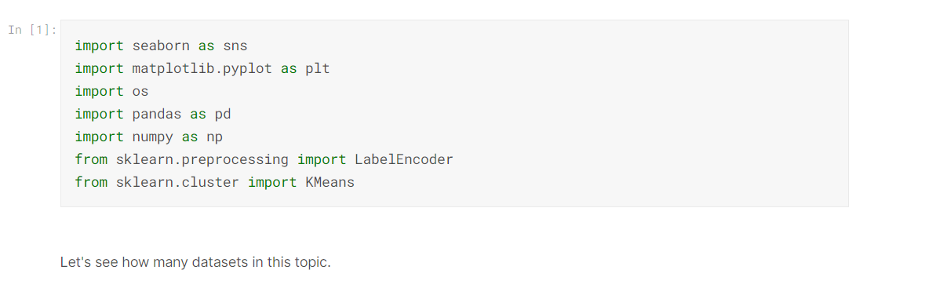
Let's see how many datasets in this topic.

Slide 4
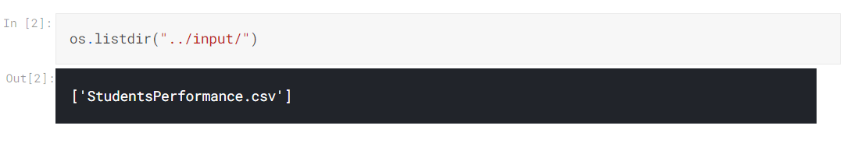
Only one! Take a look at the dataset.

Slide 5
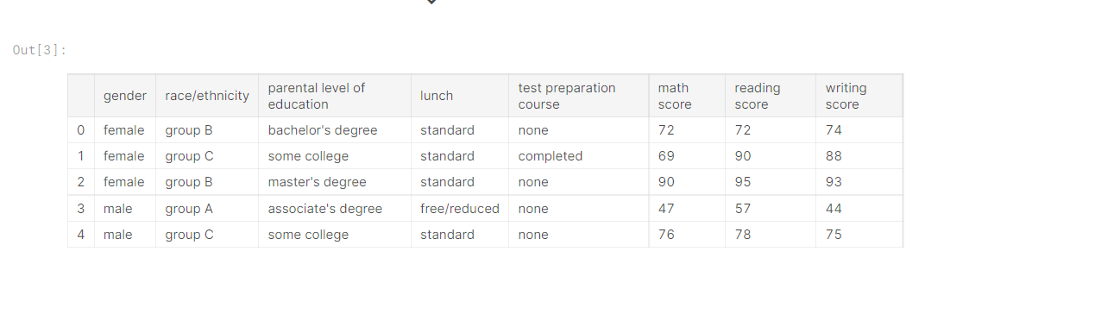
Some column names are too long, rename the column names to be simpler.

Slide 6
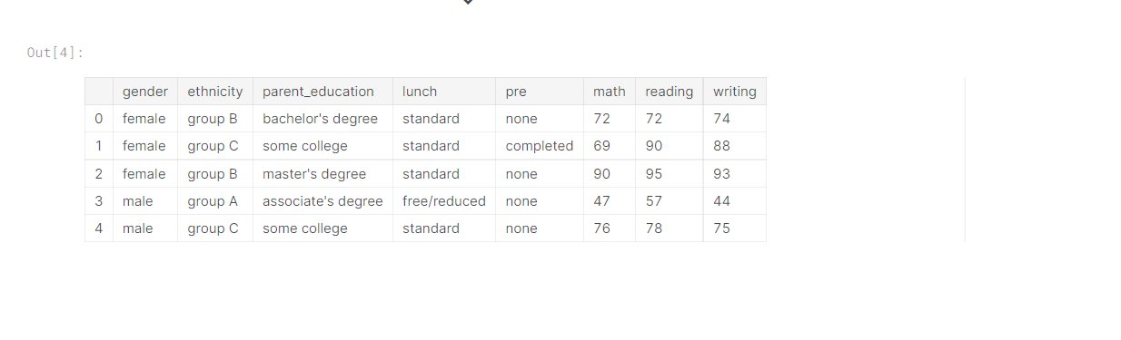
Seems clearly. Check the data type.

Slide 7
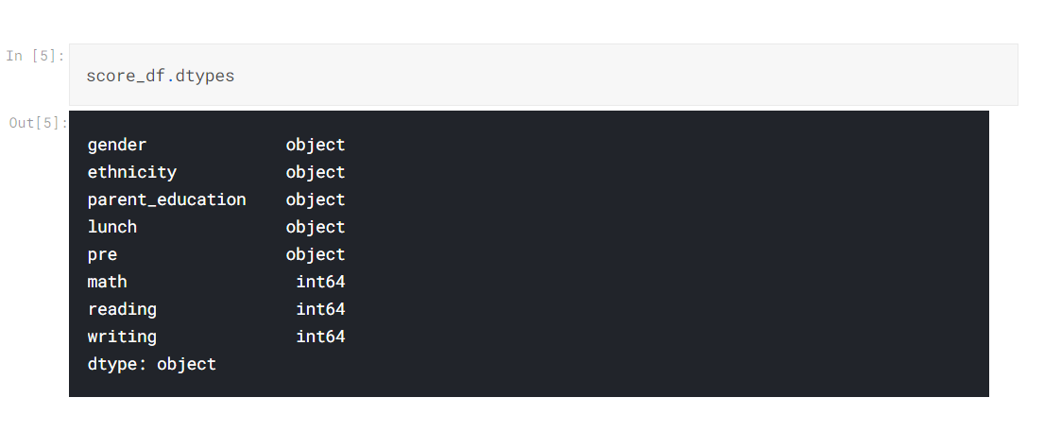
We deal with the data type later. Firstly, let's figure out the performance of each field for male and female

Slide 8
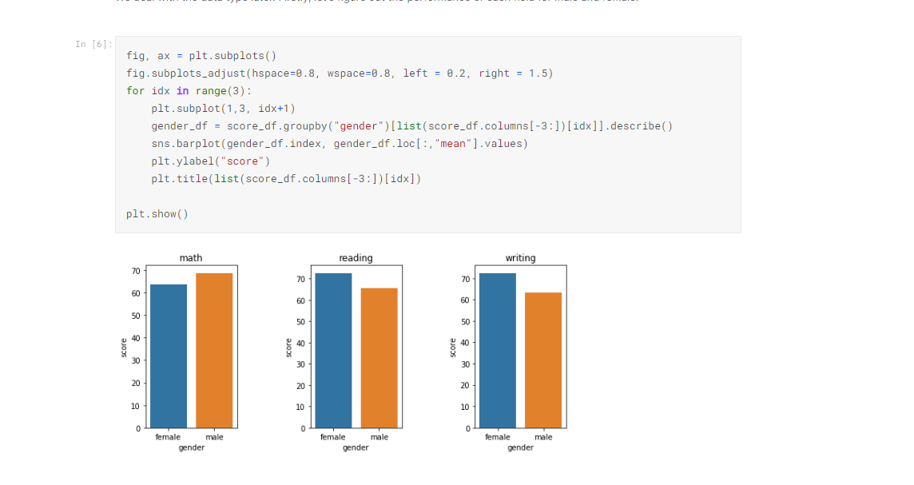
We can see that male has better performance on math field, but worse on reading and writing. Secondly, see the performance of ethnicity

Slide 9
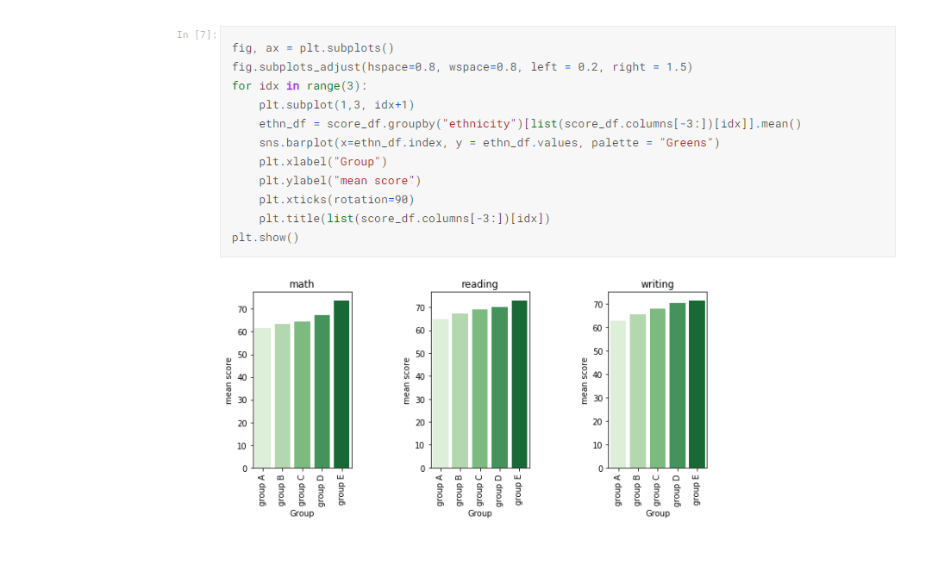
Obviously, group E has best performance for all the fields, and group A is the worst.

Slide 10
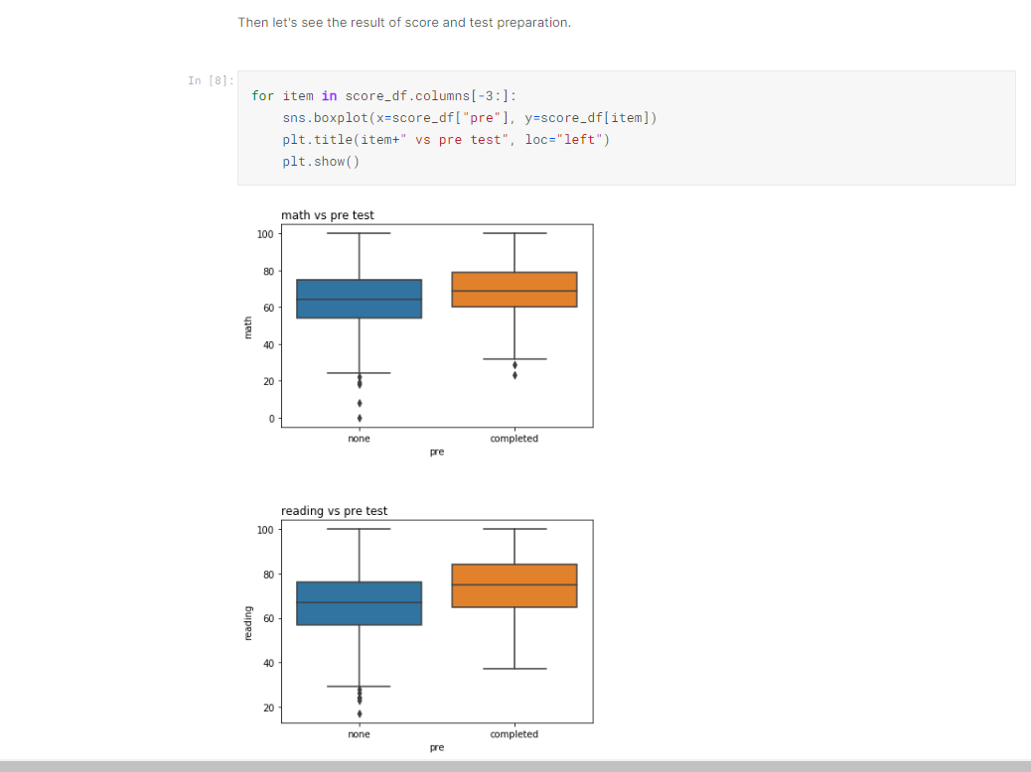
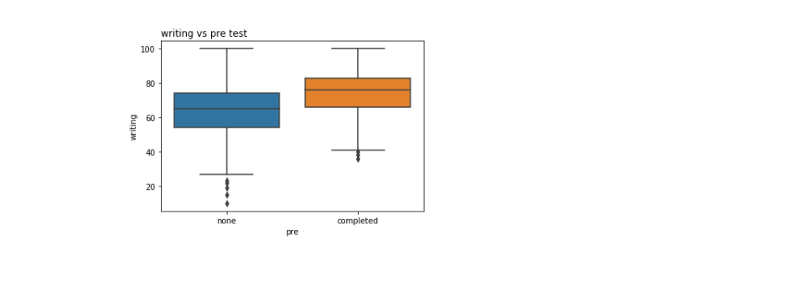
The score distribution got narrower if students complete the preparation before test, and also we can see that the average of the score is better.

Slide 11
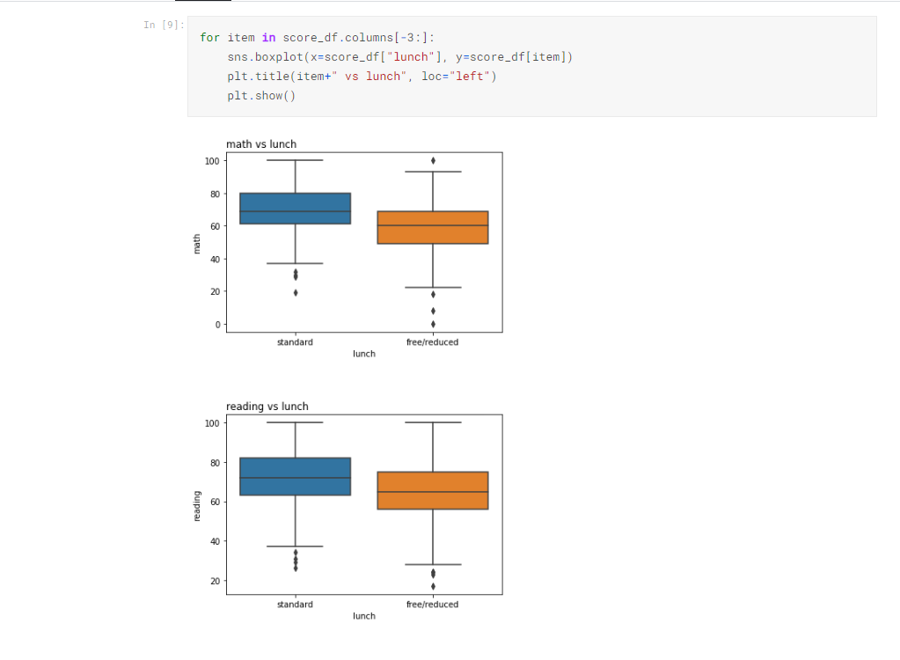
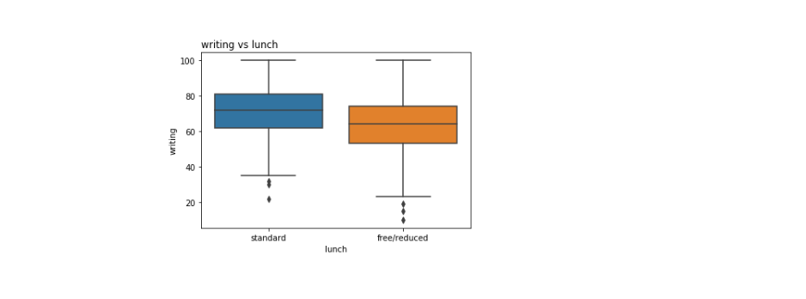
Make sense! Students are easier to get better score once they eat standardly.

Slide 12
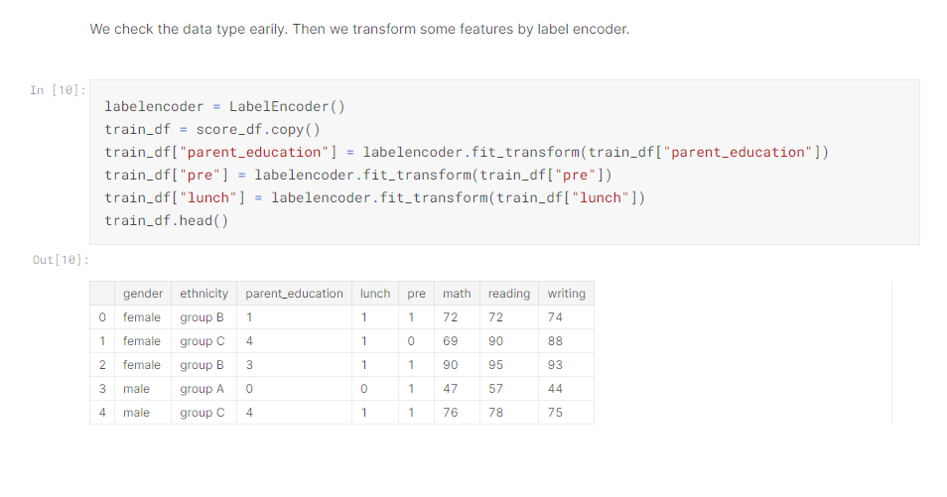
Great! The features "parent_education", "lunch" and "pre" are labeled by numbers. Next, we use KMeans argorithm to classify the dataset.

Slide 13
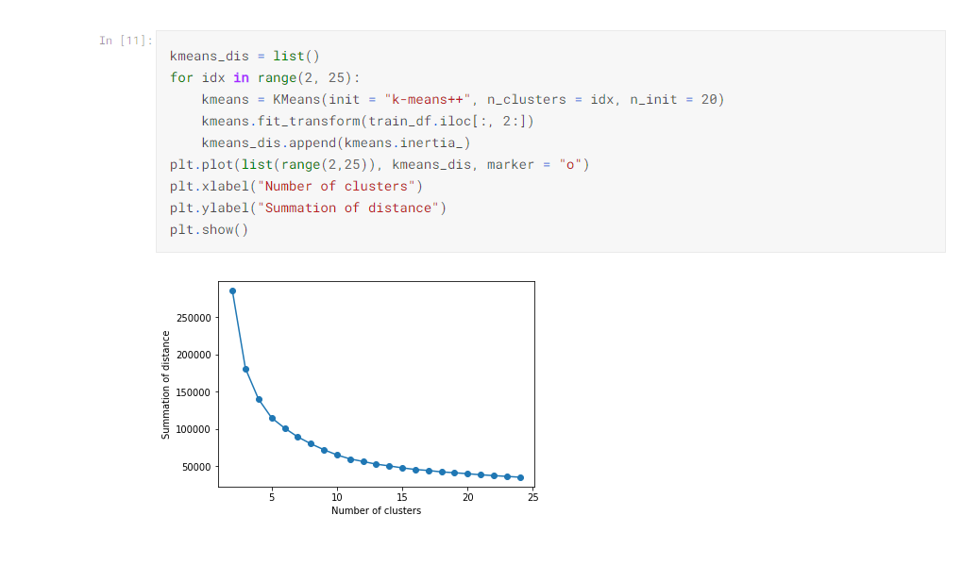
Good! We choose 8 as elbow point, and then classify all data.

Slide 14
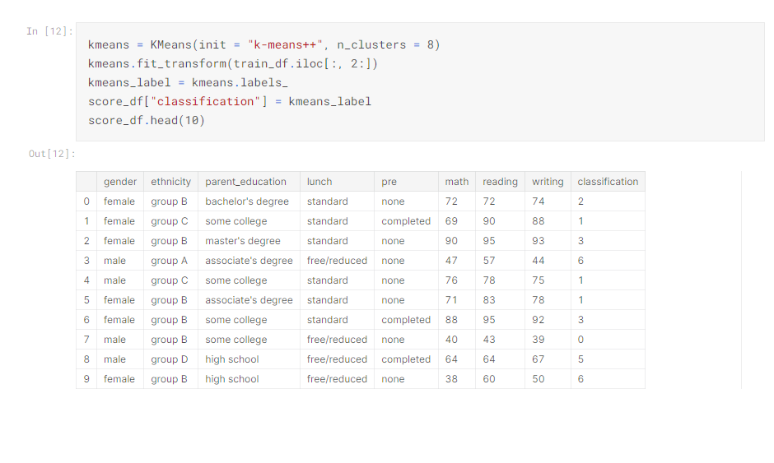
After classifying the data, let's see the performance of each cluster.

Slide 15
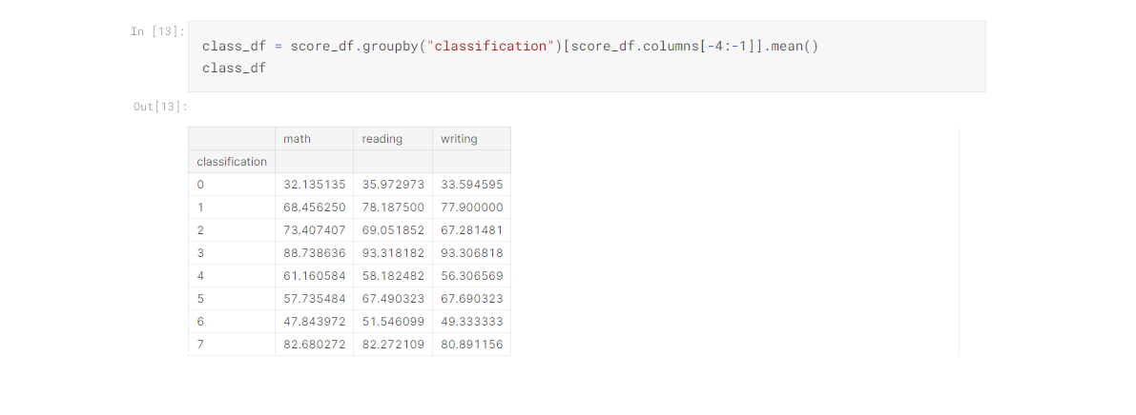

Slide 16
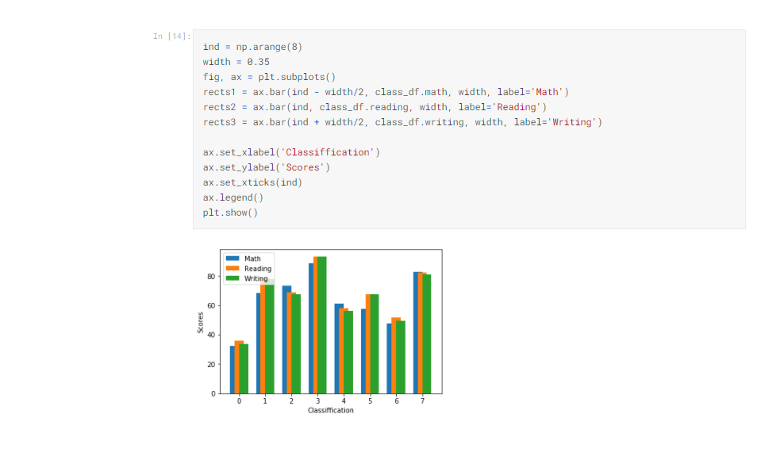
Up to now, it's obviously that all subject of cluster has the same trend, so we choose the average of all subjects to rank the clusters

Slide 17
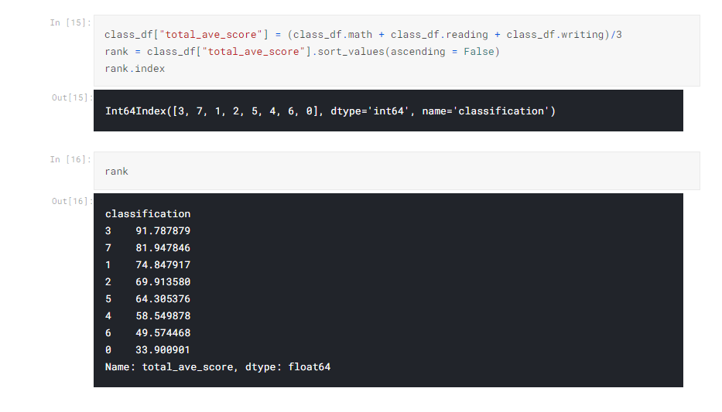
For top5 rank, the average score all passed, Rank0 is the best cluster, Rank1 is second one and so on.

Slide 18
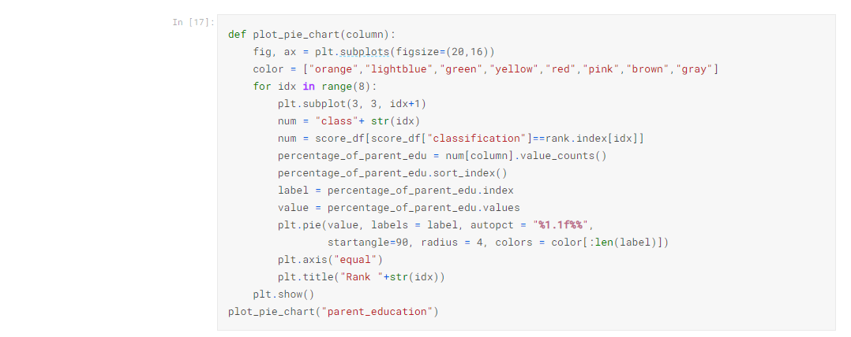
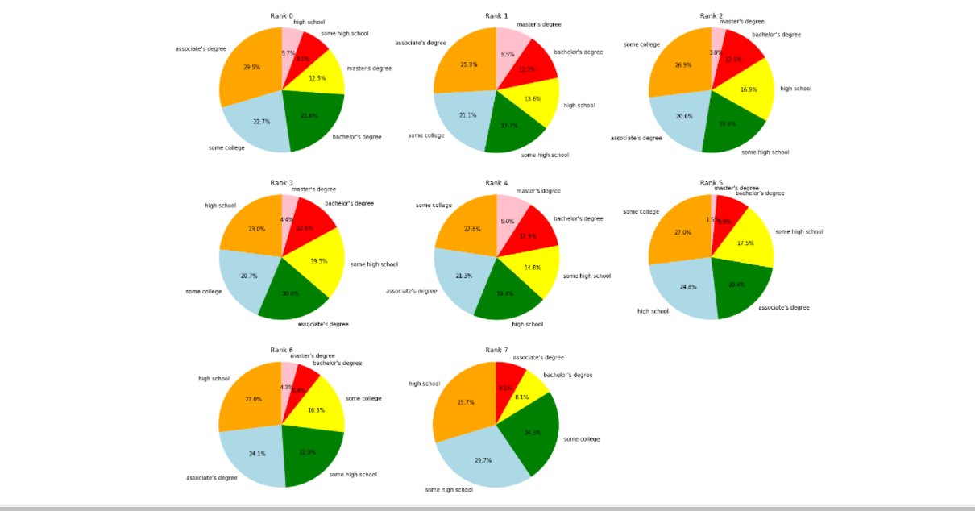
From now on, we can find out the correlation between the performance of students and features. Let's plot pie chart to see whether parents education level can affect the performance or not.

Slide 19
Let's define the high degree of education. Parents having bachelor or master degree are high-level educated. So we focus on these two terms.
As pie chart were shown above, we can easily understand the ratio of high-degree education. For the rank0, its ratio is around 32%. In addition, there are no differences between rank1 to rank3, and the ratio are around 15~17%. Finally, the ratio is only 8% in rank7.
We calculated the average score of each rank before, so we can say that parent's education affect the score but not obviously, because there are still 70%~80% parents without high education degree

Slide 20
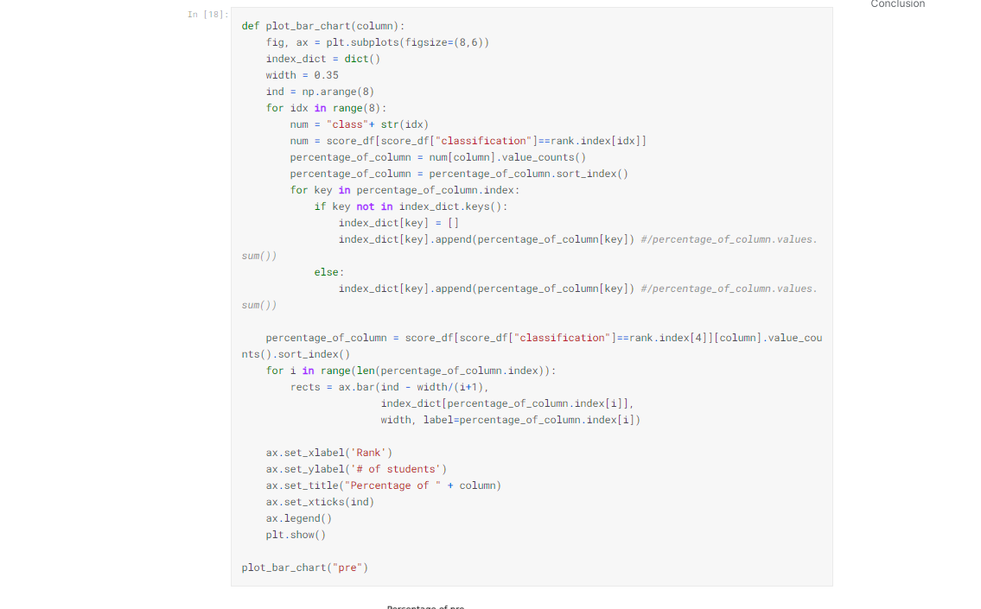
How about the test preparation course?

Slide 21
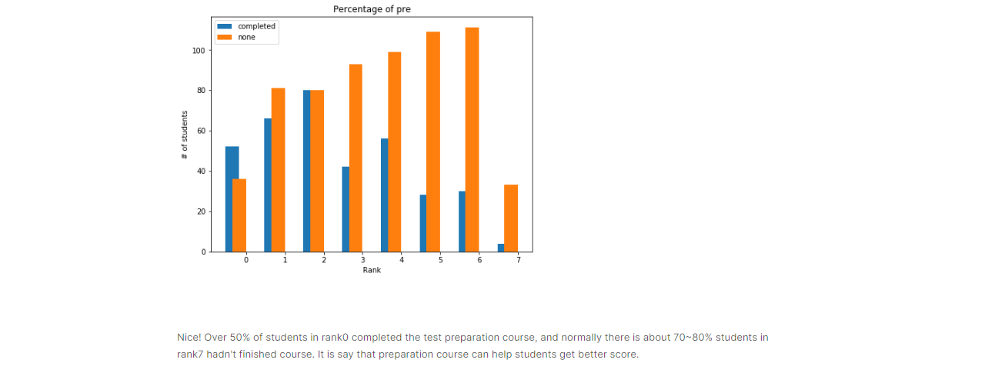
Nice! Over 50% of students in rank0 completed the test preparation course, and normally there is about 70~80% students in rank7 hadn't finished course. It is say that preparation course can help students get better score.

Slide 22
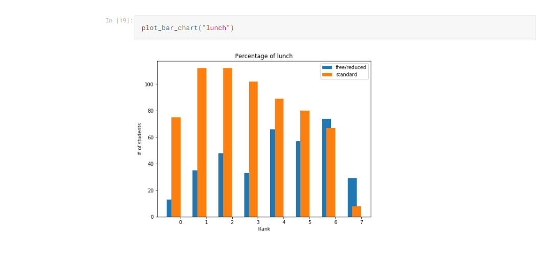
Also the same trend as "pre". Students who had lunch before test got better score. That is, it's hard to get good performance without eating.

Slide 23
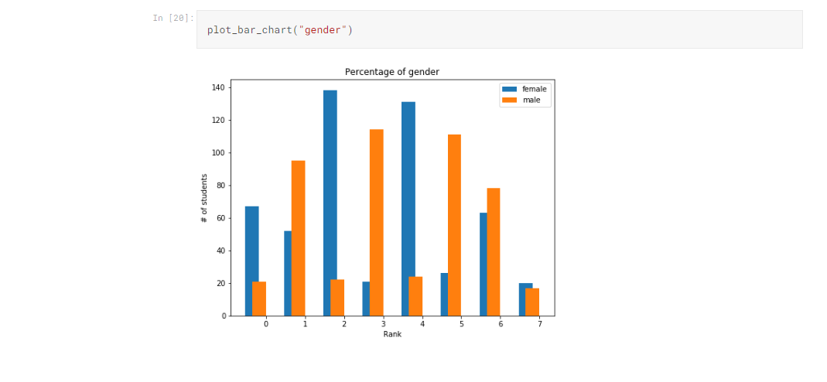
It's hard to say that the male is better than female.

Slide 24
Conclusion
There are few conclusions below:
Parents' education level may affect the performance of students, but not the important one.
Finishing preparation course is beneficial.
Having lunch is important to students, and it is also the most significant one.
Gender has no correlation with the score.
In summary, if students want to have good performance, they should have enough nutrient and make effort to prepare the test.

Slide 25
THANK YOU ALL SO VERY MUCH
END OF PRESENTATION

